Slide 1


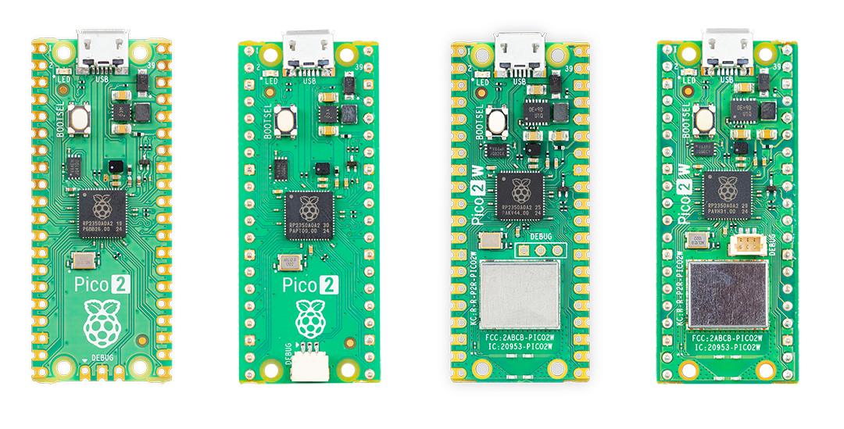
RASPBERRY PI PICO 2W
Getting Started with MQTT
MicroPython · Publish / Subscribe · HiveMQ · BME280 / DHT22 Sensor
MQTT Stack
Lecture Duration: 3–6 Hours
Level: Intermediate | MicroPython Required
Publisher (Pico 2W)
MQTT Broker (HiveMQ)
Subscriber (Pico / App)
Instructor: Sros Nhek, Ph.D.
Reference: randomnerdtutorials.com/raspberry-pi-pico-w-mqtt-micropython/

Slide 2
Lecture Contents
3–6 Hour Roadmap
01
Introduction to MQTT
05
Configuration File
What it is, why it matters for IoT
secrets, boot.py, Wi-Fi connection
02
MQTT Core Concepts
06
Publishing Messages
Pub/Sub, Topics, Messages, Broker
Sensor data → broker → topic
03
MQTT Broker Setup
07
Subscribing to Topics
HiveMQ Cloud, Mosquitto options
Receive commands, control outputs
04
Installing umqtt Modules
08
Testing & Troubleshooting
simple.py, robust.py via Thonny
MQTT Explorer, debug tips

Slide 3




Prerequisites & Parts Required
What you need before starting
Raspberry Pi Pico 2W
Thonny IDE / VS Code
BME280 / DHt22 Sensor
Wi-Fi-enabled board with MicroPython flashed
Installed and board recognized over USB
Temperature, Humidity & Pressure (I²C)
BME280 Wiring
DHt22 Wiring
Pin | Pico 2W
VCC | 3.3V
GND | GND
SDA | GP4
SCL | GP5
Pin | Pico 2W
VCC | 3.3V
GND | GND
Data | GP15
Wi-Fi Network
HiveMQ Account
2.4 GHz router with internet access
Free cloud MQTT broker (no install needed)

Slide 4
SECTION 01
Introduction to MQTT
What it is · Why IoT needs it · RFC 6455 · History

Slide 5
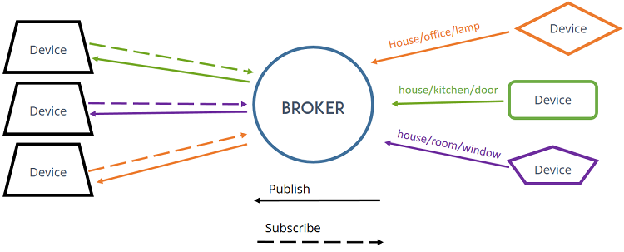
What is MQTT?
Message Queuing Telemetry Transport
Definition
Why MQTT for IoT?
MQTT stands for Message Queuing Telemetry Transport.
It is a lightweight publish-subscribe messaging protocol designed for constrained devices and low-bandwidth, high-latency networks.
Lightweight:
Minimal header overhead (2 bytes min). Perfect for microcontrollers with limited RAM.
Low Bandwidth:
Standard:
OASIS Standard & ISO/IEC 20922
Designed for slow, unreliable networks. Works over 2G/3G, LoRa, Wi-Fi.
Port:
1883 (plain) / 8883 (TLS)
Async Delivery:
Broker stores messages for offline devices (with retained messages).
Transport:
TCP/IP
Many-to-Many:
Versions:
3.1.1 (most common) · 5.0
One publisher → broker → many subscribers simultaneously.
Use Cases:
IoT, Home Automation, Telemetry
Secure:
TLS/SSL encryption + username/password authentication.
Notes:
TLS (Transport Layer Security) and SSL (Secure Sockets Layer) are cryptographic protocols designed to secure communications over a computer network. They protect sensitive data—like passwords and payment details—from being intercepted by eavesdroppers while in transit between a client (like your web browser) and a server. [1]

Slide 6
HTTP vs MQTT Comparison
Choosing the right protocol for your project
Feature | HTTP | MQTT
Communication | Request–Response (pull) | Publish–Subscribe (push/pull)
Connection | New connection per request | Persistent long-lived connection
Overhead | ~800 B HTTP headers/request | 2–4 byte MQTT frame header
Server push | Not possible (polling needed) | Native server-to-client push
Multi-client | Each client polls separately | Broker fans out to all subscribers
Best for | REST APIs, file downloads | Sensor data, IoT control, dashboards
URL scheme | http:// / https:// | mqtt:// / mqtts://
State | Stateless | Stateful (session, subscriptions)

Slide 7

SECTION 02
MQTT Core Concepts
Publish / Subscribe · Topics · Messages · Broker · QoS

Slide 8
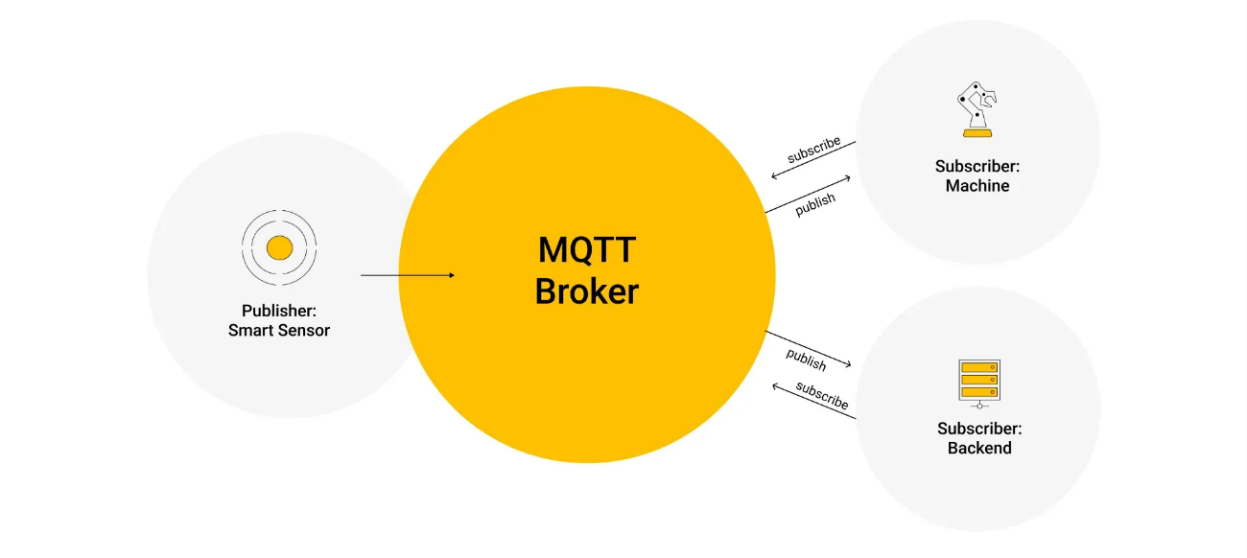

Publish / Subscribe Model
The heart of MQTT communication
Phone
App
Node-RED
Dashboard
BROKER
PUBLISHER
HiveMQ / Mosquitto
Pico 2W
(BME280 data)
Another
Pico 2W
Filters & routes
messages by topic
publishes on topic:
pico/temperature
Stores retained msgs
Manages sessions
SUBSCRIBERS
All subscribed to:
pico/temperature

Slide 9
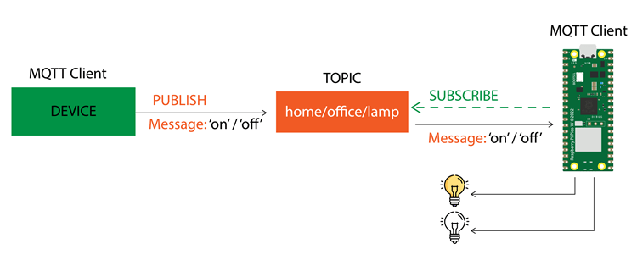
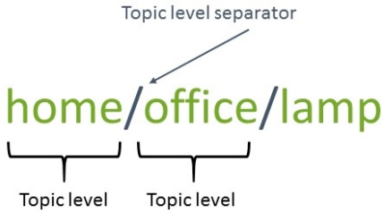
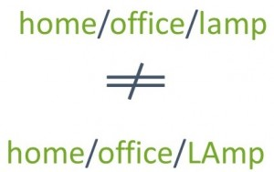
MQTT Topics
Hierarchical addressing with forward slashes
Topic Structure
Wildcards
Topics are UTF-8 strings separated by forward slashes ( / ). Each level narrows the scope:
+ (single level)
home/office/lamp
Matches exactly one level
home/+/lamp → matches
home/office/lamp
home/bedroom/lamp
home/bedroom/temperature
pico/sensor/humidity
# (multi level)
pico/led/control
Matches any remaining levels
home/# → matches
home/office/lamp
home/bedroom/temp
home/kitchen/fan
factory/line1/motor/rpm
⚠ Topics are CASE-SENSITIVE: Pico/Temp ≠ pico/temp

Slide 10
MQTT Messages & Quality of Service
QoS levels and message payload
Message Payload
Quality of Service (QoS)
MQTT messages can carry any payload — plain text, JSON, binary, or sensor values. The broker delivers them without interpreting content.
QoS 0 — At most once
Fire-and-forget. No acknowledgement. May be lost. Lowest overhead.
# Payload examples
client.publish("pico/temp", "24.5")
client.publish("pico/data", '{"t":24.5,"h":60}')
client.publish("pico/led", "ON")
QoS 1 — At least once
Message acknowledged by receiver. May be delivered more than once.
Retained Messages
When retain=True, the broker stores the LAST message on that topic. New subscribers instantly receive it without waiting for the next publish.
QoS 2 — Exactly once
4-way handshake. Guaranteed delivery, no duplicates. Highest overhead.
client.publish(topic, msg, retain = True)

Slide 11


The MQTT Broker
The message routing engine
The broker is the central hub of MQTT. It receives ALL messages, filters by topic, and delivers to all interested subscribers.
HiveMQ Cloud
Mosquitto (Local)
Mosquitto (Cloud VPS)
Cloud-hosted, free plan available. No install needed. Best for beginners and production IoT.
Open-source broker on Raspberry Pi or PC. Most popular in hobbyist and home automation projects.
Mosquitto installed on a cloud server
(e.g., DigitalOcean). Accessible worldwide from anywhere.
✓ Free tier ✓ TLS built-in ✓ Web UI ✓ No setup
✗ Requires internet access
✓ Free & open-source ✓ Local network
✓ No internet needed ✓ Lightweight
✗ Requires install & configuration
✓ Internet accessible ✓ Full control
✓ Low cost VPS
✗ Requires Linux admin skills
In this lecture: HiveMQ Cloud (free). The code is compatible with any MQTT broker — just update the connection details.

Slide 12

SECTION 03
Setting Up HiveMQ Broker
Cloud MQTT · Account Setup · Cluster URL · Access Credentials

Slide 13

HiveMQ Cloud Setup
Step-by-step broker configuration
1
Create Account
Go to hivemq.com → click 'Start Free' → choose HiveMQ Cloud plan → register or login.
2
Get Cluster URL
After login, click 'Manage Cluster'. Copy the Cluster URL (e.g. abc123.s1.eu.hivemq.cloud). Save it — you'll need it in your code.
3
Create Credentials
Click 'Access Management' tab → fill in Username and Password → set permission to Publish and Subscribe → click 'Create Credential'.
4
Collect Details
Before proceeding, make sure you have: ① Cluster URL ② MQTT Username ③ MQTT Password ④ Port: 8883 (TLS)
Port 8883 (TLS/SSL) is required for HiveMQ Cloud. Plain port 1883 will not connect. Set ssl=True in your MicroPython MQTT client.

Slide 14
MQTT Broker Details Checklist
Information needed before writing code
Required Details
Security Tips
Store credentials in secrets.py — never hardcode in main.py
MQTT Server / URL:
abc123.s1.eu.hivemq.cloud
Add secrets.py to .gitignore before pushing to GitHub
Port (TLS):
8883
Use TLS (port 8883) — plain text port 1883 exposes credentials
Username:
your_hivemq_username
Use unique Client IDs — duplicate IDs cause disconnection loops
Password:
your_hivemq_password
Rotate passwords periodically in production deployments
Client ID:
pico2w_01 (unique per device)
Using Mosquitto instead?
Just change the server URL to your Raspberry Pi's local IP (e.g. 192.168.1.10), port to 1883, and set ssl=False. The rest of the code stays identical.

Slide 15

SECTION 04
Installing umqtt Modules
simple.py · robust.py · Thonny IDE file upload · Directory structure

Slide 16
umqtt Library Overview
MicroPython MQTT client modules
umqtt.simple
simple.py
umqtt.robust
robust.py
Core MQTT client. Supports connect, publish, subscribe, wait_msg. Lightweight but does NOT auto-reconnect.
Extends simple.py with automatic reconnection. Best for long-running IoT deployments where Wi-Fi or broker drops occasionally.
Key Methods:
Key Methods:
MQTTClient(id, server)
Inherits all simple.py methods
connect()
reconnect() — auto-reconnects
publish(topic, msg)
wait_msg() — with reconnect on error
subscribe(topic)
Suitable for production use
set_callback(fn)
wait_msg()
Both modules must be placed in a folder called umqtt/ on the Pico filesystem. Source: github.com/micropython/micropython-lib

Slide 17
Installing umqtt via Thonny IDE
Step-by-step file upload to Pico filesystem
1
Open Files Sidebar
Pico 2W Filesystem
In Thonny IDE → View → Files. You'll see two panels: your computer (top) and Pico 2W filesystem (bottom).
/
Create umqtt Directory
├── boot.py
2
├── main.py
Right-click on the Pico 2W panel → New Directory → type umqtt → click OK. The folder appears in the sidebar.
├── secrets.py
└── umqtt/
3
Create simple.py
├── simple.py
Right-click on the umqtt folder → New File → name it simple.py. Paste the code from the GitHub link (see below).
└── robust.py
4
Create robust.py
Repeat step 3 for robust.py. Paste the robust.py code. Both files must be inside the umqtt/ folder.
5
Verify Structure
In Thonny's Pico panel you should see: /umqtt/simple.py and /umqtt/robust.py. You're ready to import!
Download links: github.com/RuiSantosdotme/Random-Nerd-Tutorials → Projects/Raspberry-Pi-Pico/MicroPython/mqtt/umqtt/

Slide 18

SECTION 05
Configuration & Boot Files
secrets.py · boot.py · Wi-Fi Connection · MQTT Credentials

Slide 19
Creating secrets.py
Keeping credentials out of your main code
Importing in your scripts
# secrets.py — NEVER share this file publicly!
# Add secrets.py to .gitignore before using Git
# Wi-Fi credentials
WIFI_SSID = "Your_WiFi_Name"
WIFI_PASSWORD = "Your_WiFi_Password"
# MQTT broker details (HiveMQ example)
MQTT_SERVER = "abc123.s1.eu.hivemq.cloud"
MQTT_PORT = 8883
MQTT_USER = "your_hivemq_username"
MQTT_PASSWORD = "your_hivemq_password"
MQTT_CLIENT_ID = "pico2w_01"
# In boot.py / main.py:
from secrets import (
WIFI_SSID, WIFI_PASSWORD,
MQTT_SERVER, MQTT_PORT,
MQTT_USER, MQTT_PASSWORD,
MQTT_CLIENT_ID
)
Then use WIFI_SSID, MQTT_SERVER, etc. as normal variables throughout your code.
Security Best Practices
Mosquitto users:
Set MQTT_PORT = 1883 and ssl = False in the connect call. If no password is required, pass user = None and password = None.
Never hardcode credentials directly in main.py or publish.py
Create a .gitignore file with: secrets.py
Import from secrets: from secrets import WIFI_SSID, MQTT_SERVER, ...

Slide 20
boot.py — Wi-Fi Connection
Auto-run on power-up; connects Pico 2W to Wi-Fi
boot.py Behavior
# boot.py — runs automatically on every boot
import network, time
from secrets import WIFI_SSID, WIFI_PASSWORD
def connect_wifi():
wlan = network.WLAN(network.STA_IF)
wlan.active(True)
if not wlan.isconnected():
print("Connecting to Wi-Fi...")
wlan.connect(WIFI_SSID, WIFI_PASSWORD)
timeout = 0
while not wlan.isconnected() and timeout < 20:
time.sleep(1) ; timeout += 1
print(".", end="")
if wlan.isconnected():
print("\nConnected!")
print("IP:", wlan.ifconfig()[0])
else:
print("Wi-Fi FAILED")
return wlan
connect_wifi() # Called on boot automatically
Auto-runs first
boot.py runs before main.py on every power-up or reset.
Network ready
By the time main.py runs, Wi-Fi is already connected.
Reusable
Import connect_wifi() from boot if needed in main.
Timeout guard
20-second loop prevents infinite hang on bad credentials.
Status codes
STAT_GOT_IP = 3 = success. -2 = no AP. -3 = wrong password.

Slide 21
MQTT Client Connection Helper
Connecting to the broker in MicroPython
from umqtt.simple import MQTTClient
from secrets import MQTT_SERVER, MQTT_PORT, MQTT_USER, MQTT_PASSWORD, MQTT_CLIENT_ID
def connect_mqtt():
client = MQTTClient(
client_id = MQTT_CLIENT_ID,
server = MQTT_SERVER,
port = MQTT_PORT,
user = MQTT_USER,
password = MQTT_PASSWORD,
keepalive = 60,
ssl = True, # Required for HiveMQ (TLS port 8883)
ssl_params = {"server_hostname": MQTT_SERVER}
)
client.connect()
print("Connected to MQTT broker")
return client
MQTTClient Parameters
Mosquitto (local)?
param | description
client_id | Unique ID for this device
keepalive | Ping interval in seconds (0=disabled)
ssl=True | Enable TLS — required for port 8883
Set port=1883, ssl=False, remove ssl_params. If anonymous access, set user=None and password=None. Everything else stays the same.

Slide 22
SECTION 06
Publishing MQTT Messages
Sensor Data · BME280 · Topics · JSON Payloads · Retained

Slide 23
Reading BME280 Sensor
Temperature · Humidity · Pressure over I²C
BME280 Quick Facts
# Install BME280 library first:
# Thonny → Tools → Manage Packages → 'bme280'
from machine import Pin, I2C
import bme280, time
# I2C setup: SDA=GP4, SCL=GP5
i2c = I2C(0, sda=Pin(4), scl=Pin(5), freq=400000)
bme = bme280.BME280(i2c=i2c)
# Read sensor values
values = bme.values
# values returns: ('24.50C', '60.23%', '1013.25hPa')
# Or read raw floats:
temp = round(bme.temperature, 2)
hum = round(bme.humidity, 2)
pres = round(bme.pressure, 2)
print(f'Temp: {temp}°C Hum: {hum}% Pres: {pres} hPa')
Parameter | Value
Interface | I²C or SPI
Address | 0x76 or 0x77
Temp range | -40 to +85 °C
Hum accuracy | ±3% RH
Pressure | 300–1100 hPa
Pico Pins | GP4 (SDA), GP5 (SCL)
Install BME280 library: Thonny → Tools → Manage Packages → search 'bme280' → install 'micropython-bme280'.

Slide 24
Complete Publish Script — publish.py
Sending BME280 sensor data to MQTT broker
# publish.py — publish BME280 sensor data every 10 seconds
import time, json
from machine import Pin, I2C
import bme280
from umqtt.simple import MQTTClient
from secrets import MQTT_SERVER, MQTT_PORT, MQTT_USER, MQTT_PASSWORD, MQTT_CLIENT_ID
# Topics
TOPIC_TEMP = "pico/bme280/temperature"
TOPIC_HUM = "pico/bme280/humidity"
TOPIC_PRESS = "pico/bme280/pressure"
# Hardware
i2c = I2C(0, sda=Pin(4), scl=Pin(5), freq=400000)
bme = bme280.BME280(i2c=i2c)
# Connect to broker
client = MQTTClient(MQTT_CLIENT_ID, MQTT_SERVER, MQTT_PORT,
MQTT_USER, MQTT_PASSWORD, ssl=True, ssl_params={"server_hostname": MQTT_SERVER})
client.connect()
print("MQTT connected!")
while True:
temp = str(round(bme.temperature, 2))
hum = str(round(bme.humidity, 2))
pres = str(round(bme.pressure, 2))
client.publish(TOPIC_TEMP, temp, retain=True)
client.publish(TOPIC_HUM, hum, retain=True)
client.publish(TOPIC_PRESS, pres, retain=True)
print(f'Published: {temp}°C | {hum}% | {pres} hPa')
time.sleep(10) # Publish every 10 seconds

Slide 25
Publish Code — Deep Dive
Understanding each part of publish.py
Topic Design
pico/bme280/temperature
Follow a hierarchy: device/sensor/measurement. Consistent naming makes dashboards and filtering much easier to manage.
MQTTClient()
client = MQTTClient(id, server, port, user, pwd, ...)
Creates the client object. Does NOT connect yet — just configures parameters. Call .connect() separately.
client.connect()
Initiates TCP + MQTT handshake with the broker
Sends CONNECT packet. Broker replies with CONNACK. If credentials are wrong, raises MQTTException.
client.publish()
publish(topic, msg, retain=True)
Sends PUBLISH packet. retain=True stores last value on broker — new subscribers get it immediately without waiting for next publish.
time.sleep(10)
Controls publish frequency
10 seconds is a reasonable interval for environment sensors. Adjust based on how fast values change and broker rate limits.

Slide 26

Publishing JSON Payloads
Structured data for dashboards and parsers
JSON vs Flat Topics
# Option A: Separate topics per measurement
client.publish("pico/temp", "24.5")
client.publish("pico/hum", "60.1")
# Option B: Single JSON topic (recommended)
import json
payload = json.dumps({
"temperature": temp,
"humidity": hum,
"pressure": pres,
"device": "pico2w_01"
})
client.publish("pico/sensors", payload)
# Example published JSON:
# {"temperature": 24.5, "humidity": 60.1,
# "pressure": 1013.2, "device": "pico2w_01"}
 | Flat Topics | JSON Payload
Topics | 3 publishes | 1 publish
Parsing | Simple | json.loads()
Node-RED | Multiple nodes | JSON node
Best for | Simple sensors | Multi-value
Home Assistant & Adafruit IO:
These platforms expect specific MQTT topic formats. Check their documentation for the exact topic structure and payload format.
Tip: Use json.loads(msg) on the subscriber side to parse incoming JSON. msg will be a bytes object — decode first: msg.decode()

Slide 27

SECTION 07
Subscribing to MQTT Topics
Callbacks · set_callback() · wait_msg() · LED Control

Slide 28
Subscribe — How It Works
Receiving messages from the broker
set_callback(fn)
wait_msg() / check_msg()
1
Register a Python function that fires when a message arrives on any subscribed topic.
4
wait_msg() BLOCKS until a message arrives. check_msg() is non-blocking (returns None if no message).
client.connect()
Callback fires
2
Connect to broker and establish persistent TCP session.
5
When message arrives, broker sends PUBLISH → client calls your callback function with (topic, msg).
client.subscribe(topic)
Act on message
3
Send SUBSCRIBE packet to broker. Broker notes this client wants topic messages.
6
Inside callback: decode msg, check content, control GPIO, update display, etc.

Slide 29
Complete Subscribe Script — subscribe.py
Controlling Pico LED from MQTT messages
# subscribe.py — receive commands to control onboard LED
import time
from machine import Pin
from umqtt.simple import MQTTClient
from secrets import MQTT_SERVER, MQTT_PORT, MQTT_USER, MQTT_PASSWORD, MQTT_CLIENT_ID
# Hardware
led = Pin("LED", Pin.OUT) # onboard LED
# Topic to subscribe to
TOPIC_LED = "pico/led/control"
# Callback function — called when a message arrives
def callback(topic, msg):
print(f'Received: {topic} → {msg}')
if msg == b"ON" or msg == b"1":
led.on()
print("LED turned ON")
elif msg == b"OFF" or msg == b"0":
led.off()
print("LED turned OFF")
# Connect and subscribe
client = MQTTClient(MQTT_CLIENT_ID, MQTT_SERVER, MQTT_PORT,
MQTT_USER, MQTT_PASSWORD, ssl=True, ssl_params={"server_hostname": MQTT_SERVER})
client.set_callback(callback) # Register callback BEFORE connect
client.connect()
client.subscribe(TOPIC_LED)
print(f'Subscribed to {TOPIC_LED}')
# Main loop — wait for messages
while True:
client.wait_msg() # Blocks until a message arrives

Slide 30
Subscribe Code — Deep Dive
Understanding every key line
set_callback(callback)
Must be called BEFORE connect(). The callback receives (topic: bytes, msg: bytes). Both are byte strings — compare with b"ON", not "ON".
msg == b"ON"
Messages arrive as bytes objects. Use b"..." literals or msg.decode() then compare strings. Never compare with plain strings directly.
client.subscribe(topic)
Registers interest with broker. Multiple calls allowed for different topics. One callback handles all — check topic inside callback.
wait_msg()
Blocks until ONE message arrives and calls callback. Use in a while True loop. For non-blocking: use check_msg() — returns None if no message.
check_msg()
Non-blocking alternative. Use when you have other tasks to run between checks. Call frequently (e.g., every 100ms) to avoid missing messages.
To subscribe to MULTIPLE topics: call client.subscribe() multiple times. Inside callback, check topic parameter to route messages correctly.

Slide 31
Combined Publish + Subscribe Script
One Pico that both reads sensors AND receives commands
# main.py — publish sensor data AND subscribe to LED control
import time, json
from machine import Pin, I2C
import bme280
from umqtt.robust import MQTTClient
from secrets import *
led = Pin("LED", Pin.OUT)
i2c = I2C(0, sda=Pin(4), scl=Pin(5), freq=400000)
bme = bme280.BME280(i2c=i2c)
def on_message(topic, msg):
if topic == b"pico/led/control":
led.value(1 if msg == b"ON" else 0)
client = MQTTClient(MQTT_CLIENT_ID, MQTT_SERVER, MQTT_PORT,
MQTT_USER, MQTT_PASSWORD, ssl=True, ssl_params={"server_hostname": MQTT_SERVER})
client.set_callback(on_message)
client.connect()
client.subscribe("pico/led/control")
last_publish = 0
while True:
client.check_msg() # Non-blocking — check for incoming messages
if time.ticks_diff(time.ticks_ms(), last_publish) > 10000:
t = str(round(bme.temperature, 2))
client.publish("pico/bme280/temperature", t, retain=True)
last_publish = time.ticks_ms()
Key Design Pattern
Use check_msg() (non-blocking) instead of wait_msg() when publishing too. check_msg() returns immediately so you can run other tasks. Track publish timing with ticks_ms() difference — no blocking sleep() needed.

Slide 32
umqtt.robust — Auto-Reconnect
Production-grade MQTT with reconnection handling
Problem with umqtt.simple
Solution: umqtt.robust
If the Wi-Fi or broker connection drops, simple.py raises an OSError exception and the script crashes. In a long-running IoT deployment, this is unacceptable.
robust.py extends simple.py with automatic reconnection. If the connection drops, it re-connects to the broker and re-subscribes automatically.
# simple.py behavior on drop:
# OSError: [Errno 104] ECONNRESET
# Script halts — needs manual reset
# Bad for production deployments!
# Just change the import!
# FROM:
from umqtt.simple import MQTTClient
# TO:
from umqtt.robust import MQTTClient
Symptoms:
Benefits:
• Pico stops publishing after broker restart
• No data on dashboard until manual Pico reset
• MQTT client disappears from broker list
• Reconnects automatically on Wi-Fi drop
• Re-subscribes to all topics after reconnect
• No script changes beyond the import line
→ Always use umqtt.robust for production and long-running deployments. Use umqtt.simple only for learning and quick experiments.

Slide 33
SECTION 08
Testing & Troubleshooting
MQTT Explorer · HiveMQ WebUI · Debug Tips · Common Errors

Slide 34
Testing with MQTT Explorer
Visual tool to monitor topics and publish test messages
1
Download
Other Test Tools
Get MQTT Explorer free from: mqtt-explorer.com. Available for Windows, macOS, Linux.
HiveMQ Web Client
Built-in browser client at hivemq.com/demos/websocket-client/
2
Connect
Enter broker URL, port 8883, username, password, enable TLS. Click Connect.
MQTT.fx
Desktop client, good for scripted testing
3
Monitor Topics
All topics published by your Pico 2W appear in the left panel as a tree. Click any topic to see its current value and history.
mosquitto_pub / _sub
CLI tools — fast for command-line testing
4
Publish Test
Node-RED
Right side: enter topic (e.g. pico/led/control), type payload (ON or OFF), click Publish. Your Pico receives it instantly.
Flow-based dashboard with MQTT nodes
5
Verify
Home Assistant
Check Thonny Shell on Pico side — the callback print() should show the received message confirming end-to-end success.
Full HA integration with MQTT Discovery

Slide 35
Troubleshooting Common Issues
Symptoms, causes, and fixes
Symptom | Likely Cause | Solution
OSError: ECONNRESET | MQTT connection dropped (Wi-Fi or broker restarted) | Switch to umqtt.robust for auto-reconnect
MQTTException: 5 | Wrong username or password for broker | Double-check credentials in secrets.py
OSError: -2 | Hostname not resolved (DNS failure or wrong URL) | Verify cluster URL, check Wi-Fi is connected first
Script hangs on connect() | Port mismatch: using 1883 on TLS-only broker | Use port 8883 with ssl=True for HiveMQ
Callback never fires | set_callback() called after connect() | Always call set_callback() BEFORE connect()
msg comparison fails | Comparing msg == 'ON' instead of b'ON' | Messages are bytes — use b'ON' or msg.decode()
Only publishes once | wait_msg() inside publish loop blocks indefinitely | Use check_msg() for non-blocking message checks
Broker disconnects Pico | Duplicate Client ID on same broker | Use unique MQTT_CLIENT_ID per physical device

Slide 36
Debugging Tips & Best Practices
Making MQTT development easier
Print broker responses
Verify Wi-Fi before MQTT
Add try/except around connect() and print the exception. MQTTException code 5 = bad credentials; 128+ = protocol error.
Print wlan.isconnected() and wlan.ifconfig() before attempting MQTT connect. No Wi-Fi = connection will always fail.
Test topics in isolation
Use retained messages
Use MQTT Explorer to publish to pico/led/control manually BEFORE running subscribe script. Isolates server vs client issues.
Publish with retain=True so MQTT Explorer shows the LAST value immediately when you connect — great for debugging state.
Check Thonny Shell
Binary vs string compare
All print() output from Pico appears in Thonny Shell. Add verbose prints in callback to trace every received message.
Print type(msg) inside callback. It will show <class 'bytes'>. Use msg.decode() == 'ON' or msg == b'ON'.

Slide 37
MQTT with Node-RED Dashboard
Visualizing Pico sensor data in real time
Node-RED MQTT Setup
Node-RED Flow
1
Install Node-RED
npm install -g node-red (on Raspberry Pi or PC)
mqtt in
pico/bme280/#
2
Open browser
Navigate to http://localhost:1880
json
3
Add MQTT-in node
Drag 'mqtt in' node. Configure broker URL, port, credentials.
Parse JSON
4
Set topic
Set topic to pico/bme280/# (wildcard for all sensor readings)
gauge
Temperature
5
Add dashboard
Install node-red-dashboard, add 'gauge' or 'chart' nodes
chart
6
Connect & Deploy
Wire MQTT-in → JSON → Gauge. Click Deploy. Open /ui dashboard.
History
Other MQTT Platforms:
Home Assistant · Adafruit IO · OpenHAB · Grafana + InfluxDB

Slide 38
Home Assistant MQTT Integration
Connecting Pico 2W to home automation
HA MQTT Discovery
# MQTT Discovery for Home Assistant
# HA auto-detects device if you publish to correct topic
import json
# Step 1: Publish device discovery config
config_topic = "homeassistant/sensor/pico_temp/config"
config_payload = json.dumps({
"name": "Pico Temperature",
"device_class": "temperature",
"state_topic": "pico/bme280/temperature",
"unit_of_measurement": "°C",
"unique_id": "pico2w_temp_01"
})
client.publish(config_topic, config_payload, retain=True)
# Step 2: Publish sensor data as usual
# home/pico/bme280/temperature → HA reads it automatically
client.publish("pico/bme280/temperature", str(temp), retain=True)
Enable MQTT integration in HA Settings → Devices
Configure broker URL (same HiveMQ or local Mosquitto)
Publish config payload to homeassistant/<domain>/<id>/config
HA auto-creates entity — appears in dashboard immediately
State updates flow via state_topic — same as regular publish
MQTT Discovery eliminates manual HA entity config. Publish the config JSON once and HA auto-discovers your Pico as a device with all its sensors.

Slide 39
Advanced: Last Will & Testament (LWT)
Knowing when your Pico goes offline
What is LWT?
LWT Use Cases
LWT lets you specify a message that the broker publishes AUTOMATICALLY if your Pico disconnects ungracefully (power loss, Wi-Fi drop, crash). Other subscribers receive the offline notice immediately.
Device presence
Dashboard shows 🟢 online / 🔴 offline per device
Alert system
# Set LWT before calling connect()
client.set_last_will(
topic = "pico/status",
msg = "offline",
retain = True,
qos = 1
)
client.connect() # LWT registered in CONNECT packet
Node-RED sends email if device goes offline unexpectedly
HA availability
Home Assistant uses LWT to mark entity as unavailable
Fleet monitoring
When Pico connects cleanly, it publishes 'online' itself. The broker sends 'offline' only on ungraceful disconnect.
Track which of many Pico devices are currently active
# On clean boot: announce online status
client.publish("pico/status", "online", retain=True)

Slide 40
Summary & Key Takeaways
What you've learned in this lecture
MQTT Protocol
secrets.py
Lightweight pub/sub over TCP. RFC 6455. Ports 1883 (plain) / 8883 (TLS). Minimal overhead — perfect for IoT.
Store all credentials in secrets.py. Never hardcode in main script. Add to .gitignore.
Core Concepts
Publishing
Publish, Subscribe, Topics (hierarchical, case-sensitive), Messages (any payload), Broker (filters & routes).
MQTTClient → connect() → publish(topic, msg, retain=True). Use JSON for multi-value payloads.
Broker Setup
Subscribing
HiveMQ free cloud (no install), Mosquitto local (Raspberry Pi), or cloud VPS. Need URL, port, username, password.
set_callback() BEFORE connect(). subscribe(topic). wait_msg() blocks; check_msg() non-blocking.
umqtt Modules
Production Tips
simple.py = basic MQTT client. robust.py = auto-reconnect. Install in /umqtt/ folder on Pico filesystem.
Use robust.py, unique client IDs, LWT for offline detection, check_msg() for multi-task loops.

Slide 41
MicroPython MQTT — Quick Reference Cheat Sheet
Raspberry Pi Pico 2W · umqtt.simple / umqtt.robust
# Connect to broker
from umqtt.robust import MQTTClient
client = MQTTClient(client_id, server,
port, user, pwd, ssl=True,
ssl_params={"server_hostname": server})
client.set_callback(callback_fn)
client.connect()
# Callback template
def callback(topic, msg):
t = topic.decode()
m = msg.decode()
if t == "pico/led":
led.value(1 if m=="ON" else 0)
# Publish
client.publish(topic, msg)
client.publish(topic, msg, retain=True)
# Subscribe
client.subscribe("home/+/lamp")
# Wait: blocking / non-blocking
client.wait_msg()
client.check_msg()
# Pub + Sub main loop
last = 0
while True:
client.check_msg() # non-blocking
if time.ticks_diff(time.ticks_ms(), last) > 10000:
client.publish(topic, data, retain=True)
last = time.ticks_ms()
# LWT: client.set_last_will(topic, 'offline', retain=True, qos=1) — BEFORE connect()

Slide 42
Review Questions & Lab Checklist
Verify your understanding
Review Questions
Lab Checklist
What does MQTT stand for, and what is its primary design goal?
HiveMQ account created & cluster URL saved
Explain the publish/subscribe model. How does it differ from HTTP?
umqtt/simple.py uploaded to Pico
What is the role of the MQTT broker? Name two broker options.
umqtt/robust.py uploaded to Pico
What are MQTT topic wildcards? Give an example of + and # usage.
secrets.py created with correct credentials
What is the difference between QoS 0, 1, and 2?
boot.py connects Pico 2W to Wi-Fi
Why must set_callback() be called BEFORE connect()?
publish.py sends BME280 data successfully
What is the difference between wait_msg() and check_msg()?
subscribe.py controls Pico LED from MQTT
Why use umqtt.robust instead of umqtt.simple in production?
MQTT Explorer shows published topics
What happens if two devices share the same MQTT Client ID?
Multi-client test: two subscribers update together
How do MQTT retained messages benefit late-joining subscribers?
Bonus: Node-RED or HA dashboard running

Slide 43
End of Lecture
Raspberry Pi Pico 2W — Getting Started with MQTT
MicroPython · umqtt · HiveMQ · Pub/Sub · BME280 · Node-RED
You can now connect any Pico 2W sensor to any MQTT-enabled platform!

